Slide 1

Page 001
AI-Powered SQL Documentation Generator Submitted To: Infinite Computer Solutions Presented By: Team 19
STORED PROCEDURE DOCUMENTER
T E A M 1 9 | D I E T
Murapaka Venkata Daya (24U45A0233 Bheemuni Mahesh (23U41A0508) Nammi Lokesh (24U45A0421) Donkada Yamini (23U41A4218)
Team 19
2026

Slide 2


Stored procedures are often undocumented, leaving teams with no reference for understanding complex database logic.
Page 002
PROBLEM STATEMENT
New developers struggle to understand existing database logic, causing delays in onboarding and project delivery.
Manual documentation is time-consuming and error-prone, diverting developer effort from core tasks.
Critical knowledge remains with senior developers, making maintenance and debugging increasingly difficult.
Stored Procedure Documenter

Slide 3
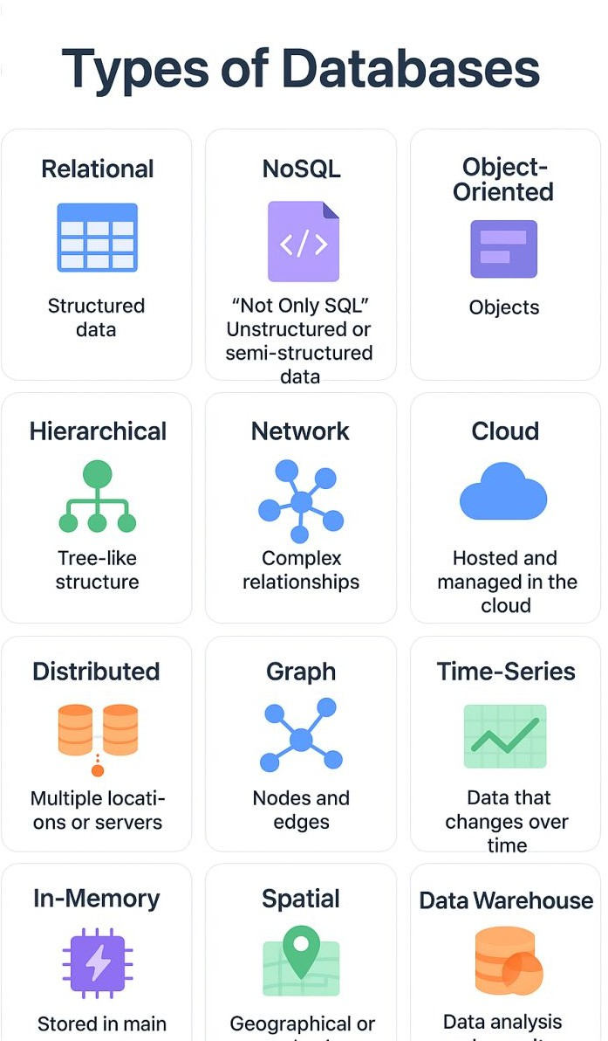
PROJECT OBJECTIVE
Page 004
Objective
To develop an AI-powered system that automatically analyzes SQL stored procedures and generates structured, readable Markdown documentation with minimal human effort.
Key Goals
Automate SQL analysis and documentation. Reduce onboarding time for new developers. Eliminate dependency on manual documentation processes.
e ent ti Design

Slide 4
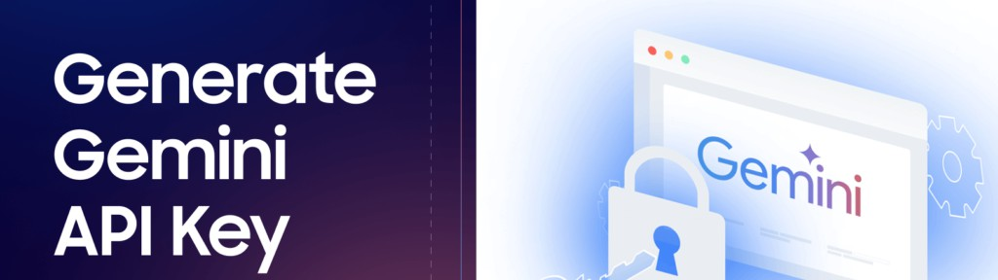
THE NEED
Page 003
Current Challenges:
Stored procedures are often undocumented.
New developers struggle to understand existing database logic.
Manual documentation is time-consuming.
Knowledge remains with senior developers.
The Solution Need:
An automated system that converts SQL stored procedures into professional, structured documentation — saving time, reducing knowledge gaps, and improving maintainability.
Stored Procedure Documenter

Slide 5
Page 005
01
SQL Parsing
Automatically reads and parses SQL stored procedure syntax, identifying parameters, logic blocks, cursors, and control flow structures with high accuracy.
02
AI Analysis
Leverages large language models to interpret procedure logic, infer intent, describe input/output parameters, and generate human-readable summaries.
03
Markdown Generation
Converts AI-analyzed procedure data into clean, structured Markdown documentation — including headers, tables, and code blocks — ready for use.
04
Professional Output Produces polished, consistent documentation suitable for
onboarding, audits, and maintenance
— eliminating manual effort and knowledge silos.
Key Features

Slide 6
Working
Page 006
01
Upload Stored Procedure
The user uploads or pastes a SQL stored procedure into the system. The input can be a raw .sql file or plain text. The system accepts procedures from major database platforms including SQL Server, MySQL, and PostgreSQL, ensuring broad compatibility for development teams.
02
AI Analyzes and Documents
The AI engine parses the stored procedure, identifies its purpose, parameters, logic flow, and return values. It then automatically generates structured Markdown documentation including descriptions, parameter tables, and usage examples — ready for immediate use by developers.
Presentation Design

Slide 7
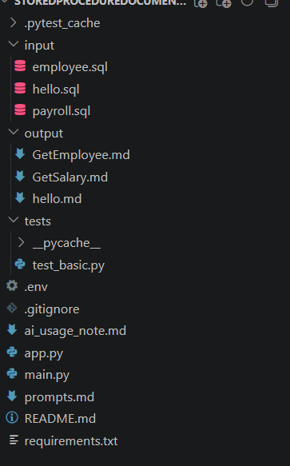
SYSTEM ARCHITECTURE
Page 008
The Stored Procedure Documenter is built on a layered architecture that ensures seamless flow from raw SQL input to structured, professional Markdown documentation output.
Input Layer
Accepts raw SQL stored procedures via file upload or direct text input. Validates syntax and prepares the query for processing.
SQL File
↓
Code Walking Engine (SQLGlot + Regex)
↓
Metadata Extraction
↓
Prompt Engineering
↓
Google Gemini AI
↓
Markdown Documentation
↓
Preview & Download
Processing Engine
Parses SQL logic, identifies procedure structure, parameters, and dependencies. Extracts metadata and logical flow.
AI Module
Leverages AI models to interpret logic, infer intent, and generate natural language descriptions for each procedure component.
Output Generator
Produces structured Markdown documentation with summaries, parameter tables, logic flow, and usage examples.
Code-Walking RAG Approach Retrieval → Augmentation → Generation

Slide 8
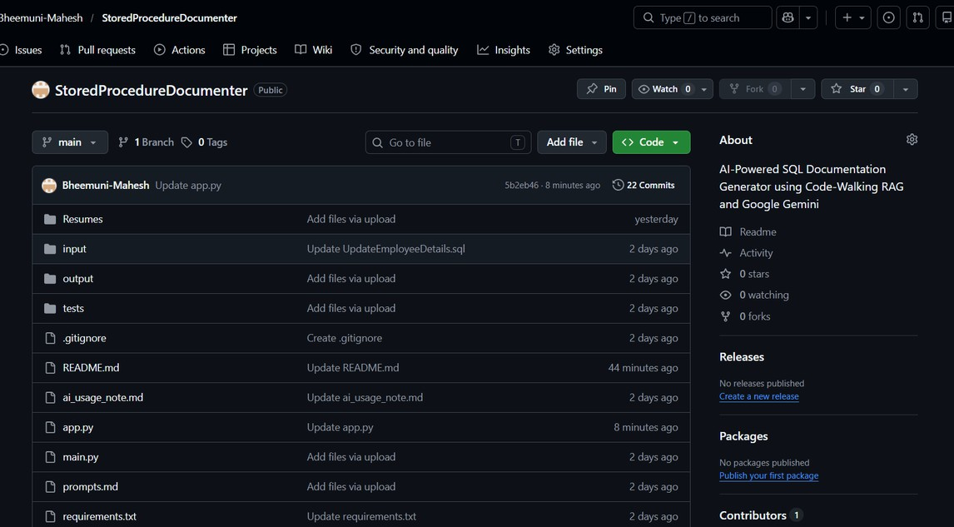
MAIN.PY (CLI APPLICATION)
Page 011
Purpose:
Command-Line Documentation Generator
Functions:
walk_sql_code()
Parses SQL
Extracts metadata generate_docs()
Builds prompt
Calls Gemini AI main()
Reads SQL files
Generates Markdown files
https://github.com/Bheemuni-Mahesh/StoredProcedureDocumenter
- Github repository(Access the code here)
Features:
Batch Processing
Retry Logic
Automatic File Handling
Output Generation
Stored Procedure Documenter

Slide 9
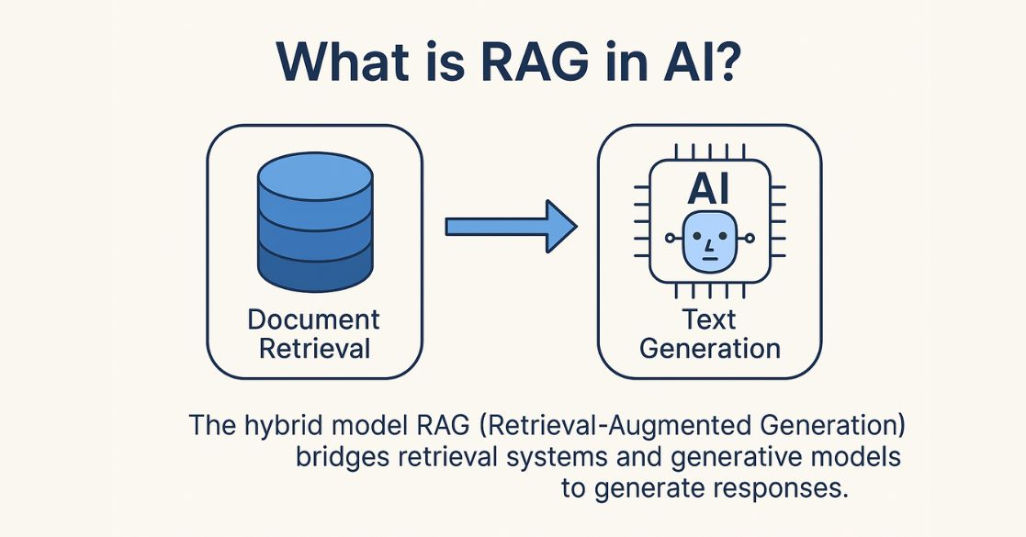
CODE-WALKING RAG
AI Capability Demonstrated
Code-Walking Retrieval Augmented Generation
Metadata Extracted:
• Procedure Name • Parameters • Tables Accessed • SQL Operations • WHERE Conditions • Error Handling • Transactions • Return Values

Slide 10
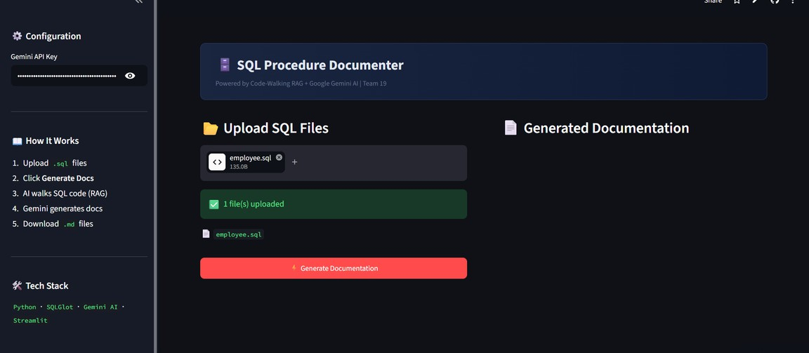
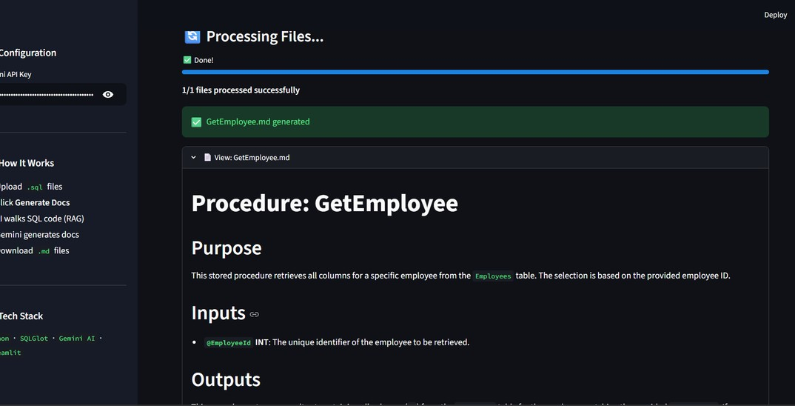
APP.PY (STREAMLIT WEB APPLICATION)
Page 011
Purpose:
Interactive User Interface
Features:
Upload Multiple SQL Files
Real-Time Processing
Documentation Preview
Download Button
Progress Tracking
API Key Input
Professional Dashboard
Deployment:
Streamlit Cloud
Live Demo:
https://sql-procedure-documenter.streamlit.app/
Stored Procedure Documenter
EXPLORE FEATURES

Slide 11
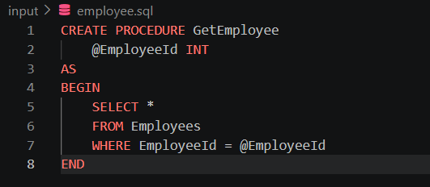
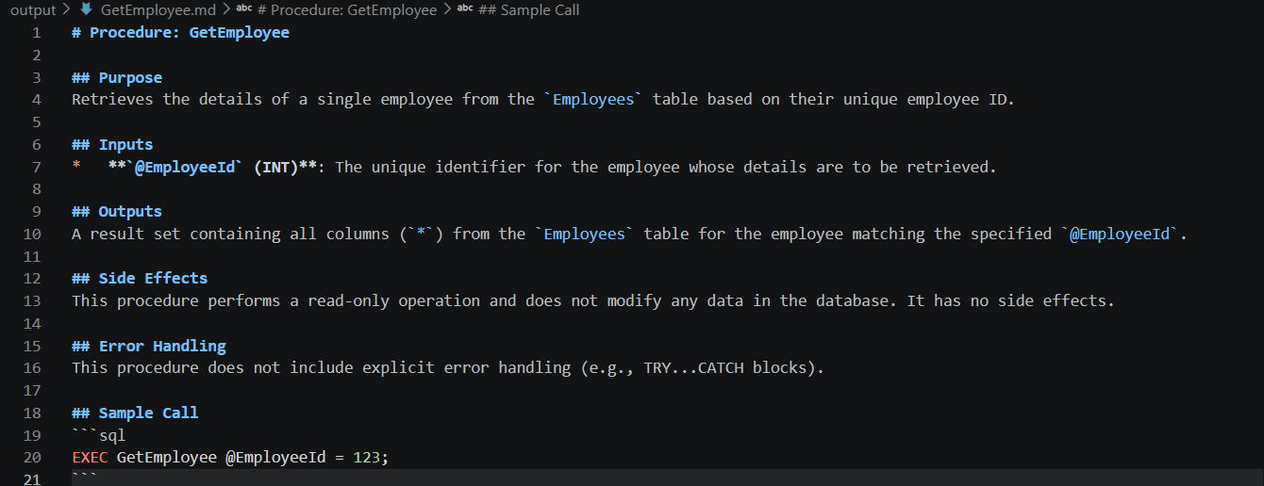
SAMPLE INPUT & OUTPUT
Input:
CREATE PROCEDURE GetEmployee @EmployeeId INT AS BEGIN SELECT * FROM Employees WHERE EmployeeId=@EmployeeId END
Output:
Purpose: Retrieves employee information.
Inputs: @EmployeeId
Outputs: Employee details
Sample Call: EXEC GetEmployee 101

Slide 12

TECHNOLOGIES USED
Page 007
Python
Core programming language
Streamlit
Interactive Web Application
SQLGlot
SQL Parsing & Validation
Regex
Metadata Extraction
Google Gemini AI
Documentation Generation
Markdown
Output Documentation Format
Git & GitHub
Version Control
Streamlit Cloud
Deployment Platform

Slide 13
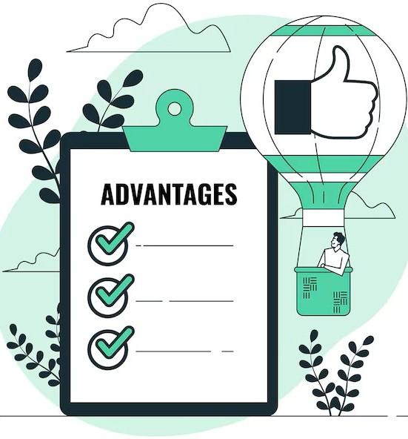

ADVANTAGES & LIMITATIONS
Page 010
Advantages
Saves Time
Reduces Manual Work
Improves Maintainability
AI-Assisted Understanding
Consistent Documentation
Easy to Use
Limitations
Depends on Gemini API
Daily API Quotas
Supports mainly T-SQL
Complex SQL may require review

Slide 14
CONCLUSION
Page 009
Successfully developed and deployed an AI-powered Stored Procedure Documentation Generator using Python, SQLGlot, Streamlit, and Google Gemini AI.
The project automates documentation generation, reduces developer effort, improves maintainability, and demonstrates practical use of AI in software engineering.
KEY POINTS :
Provides both CLI and Web-based interfaces for ease of use.
Demonstrates the practical use of AI in software engineering and database management.
Can be extended with additional database support and advanced documentation features in the future.

Slide 15


Presented to Infinite Computer Solutions

Slide 16
ANY QUESTIONS ?

